Slide 1
Exploring the Impact of AI on the Academic Performance of University Students.
Md. Jubair Hasan Miraz
ID : 211-15-14631
And
Md Robiullah Prince Mehedi
ID : 211-15-14637
Department of CSE
Daffodil International University
Ms Tapasy Rabeya
Lecturer (Senior Scale)
Department Of CSE
Daffodil International University

Slide 2
Outline
Introduction
Motivation
Objective
Expected Outcomes
Related Works
Methodology
Results & Analysis
Conclusion
References
Q & A

Slide 3
Introduction
The rapid advancement of artificial intelligence (AI) has significantly transformed various sectors, including education. The prime goal of this research is to find the full impact of AI on the academic performance of university students. Specifically, the study aims to assess how AI tools and platforms influence not only students learning habits, efficiency, and academic results, but also their mental well-being, productivity rates, and long-term retention.

Slide 4
Motivation
Motivation:
Bridge the gap in understanding AI’s impact on education.
Explore AI’s role in boosting productivity.
Assess AI’s potential in supporting mental health.
Examine AI’s role in enhancing long-term knowledge retention.

Slide 5
Objective
Objectives:
Analyze AI’s integration into academic routines.
Assess AI’s impact on productivity and academic performance.
Investigate AI tools for mental health support.
Evaluate AI’s effectiveness in supporting deeper learning and understanding of academic topics.

Slide 6
Expected Outcomes
Enhanced Productivity: AI tools streamline study routines, automate tasks, and provide personalized recommendations, boosting students' efficiency.
Improved Mental Health Support: AI-driven solutions like chatbots and virtual coaches offer timely, tailored emotional support.
Increased Retention Rates: AI enhances knowledge reinforcement and creates engaging learning environments, improving student retention.

Slide 7
Related Works
Smith (2019): AI-enabled systems significantly improve student engagement and learning outcomes (Survey-based study).
Brown & Zhao (2020): AI shows potential in mental health intervention but has limited application in academics (Qualitative analysis).
Khan et al. (2021): Adaptive AI tools enhance short-term productivity, but their impact on long-term retention is unclear (Experimental study).

Slide 8
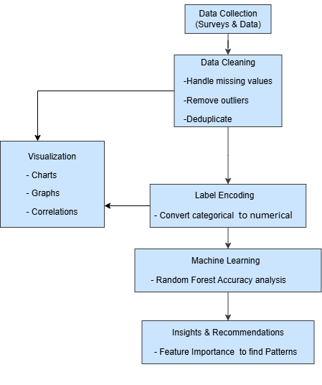
Methodology
Workflow Diagram:

Slide 9
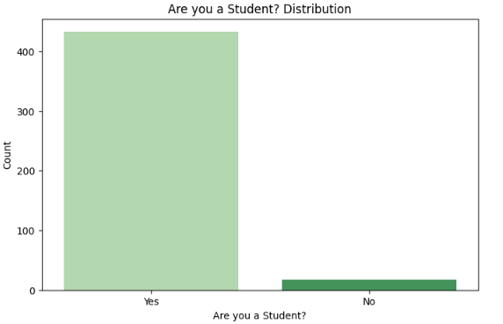
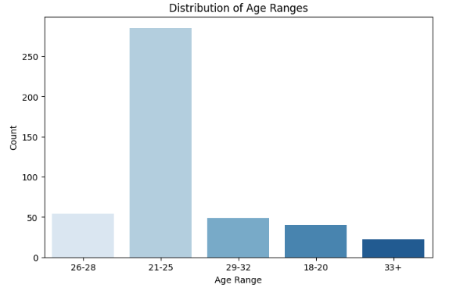
Result and Analysis
Respondents Nature:

Slide 10
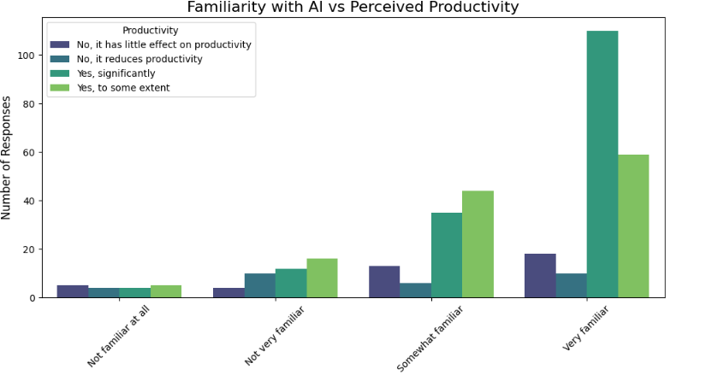
Result and Analysis
AI Familiarity vs. Productivity:
A total of 251 respondents believe AI positively impacts productivity, with the highest positive responses (211) coming from those "Very familiar" with AI, followed by 84 from "Somewhat familiar" individuals.

Slide 11
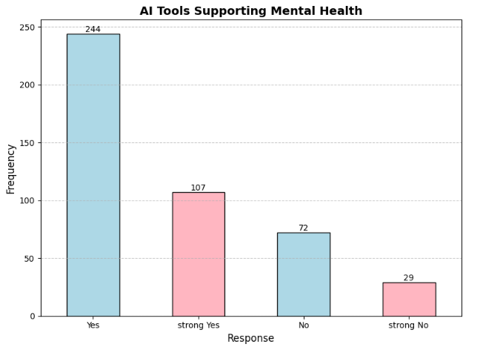
Result and Analysis
AI Tools Supporting Mental Health:
The chart highlights that most respondents (~244) view AI tools as moderate (yes) effective in supporting mental health, with fewer (~107) believing they are significantly effective. with ~72 seeing little effect and ~29 deeming AI ineffective. Overall, there is optimism about AI's potential in this area.

Slide 12
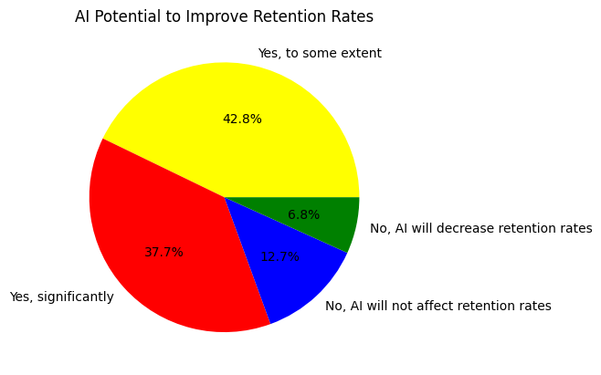
Result and Analysis
AI Improving Retention Rates:
A significant majority (80.5%) believe AI can positively impact retention, with 42.8% expecting a moderate improvement and 37.7% expecting a substantial boost.

Slide 13
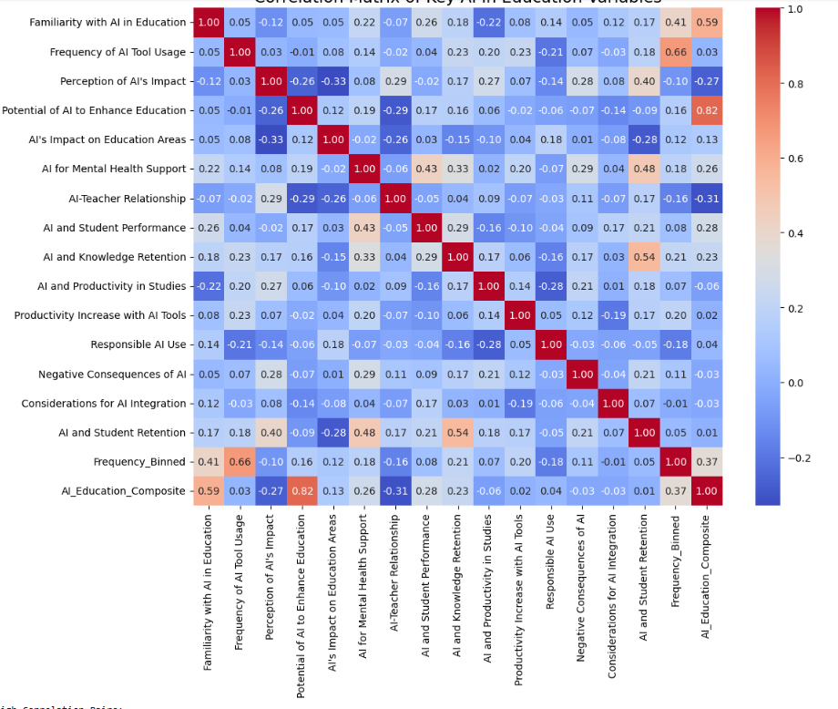
Result and Analysis
Correlation:
Productivity Increase with AI Tools & AI usage in Studies (1.00)
AI Knowledge Retention & AI and Student Performance (0.54)
Potential of AI to Enhance Education & AI Education Composite (0.82)
AI Education Composite:
2.How familiar are you with the concept of Artificial Intelligence (AI) in education?
5. Do you believe AI has the potential to enhance the quality of education?

Slide 14
Result and Analysis
Random Forest Accuracy Analysis
Impact of AI on Academic Performance
Accuracy Achieved : 86.47%
Key Insights:
Consistently high precision: 0.95(95% positive prediction were correct) and high recall(actual posative): 1.00 emphasize AI’s has effectiveness in improving academic performance.
Productivity in Studies with AI tools
Accuracy Achieved : 88.50%
Key Insights:
High precision: 1.00 and high recall: 0.95 shows AI tools enhance productivity.
High f1-scores: 0.97 validate AI as a productivity enhancer.

Slide 15
Result and Analysis
Random Forest Accuracy Analysis
Student long term Retention
Accuracy Achieved: 83.82%
Key Insights:
High precision (0.94) and recall (1.00) show AI’s role in improving retention.
Moderate f1-score (0.75) for underperforming classes indicates areas for targeted interventions.
Mental Health Support
Accuracy Achieved : 81.75%
Key Insights:
High precision (0.92) and moderate recall (0.79) shows it helps with mental well-being.

Slide 16
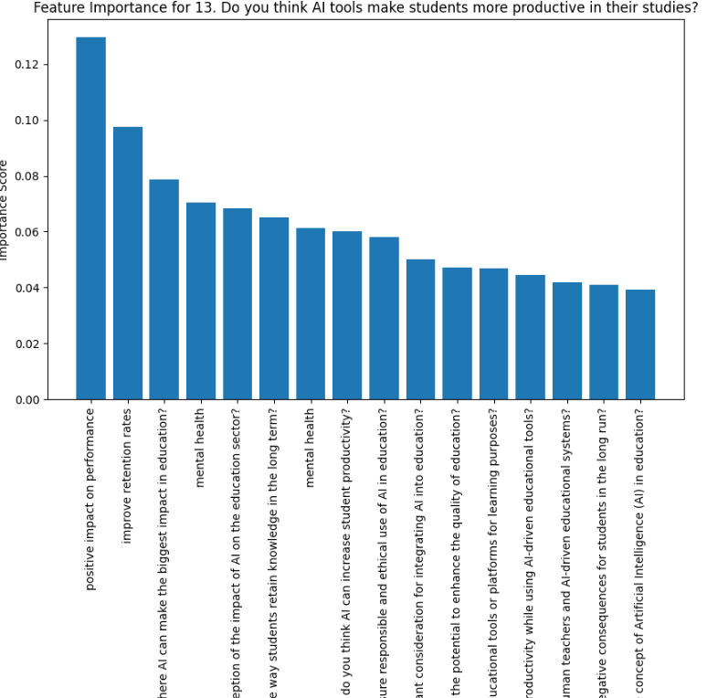
Result and Analysis
Feature Importance and Recommendations:
AI's Impact on Student Productivity:
Top features:
AI’s positive impact on performance has the highest importance score at 0.1296
.AI's impact on retention (0.0975)
Recommendation: Strengthen AI’s impact on performance, retention.

Slide 17
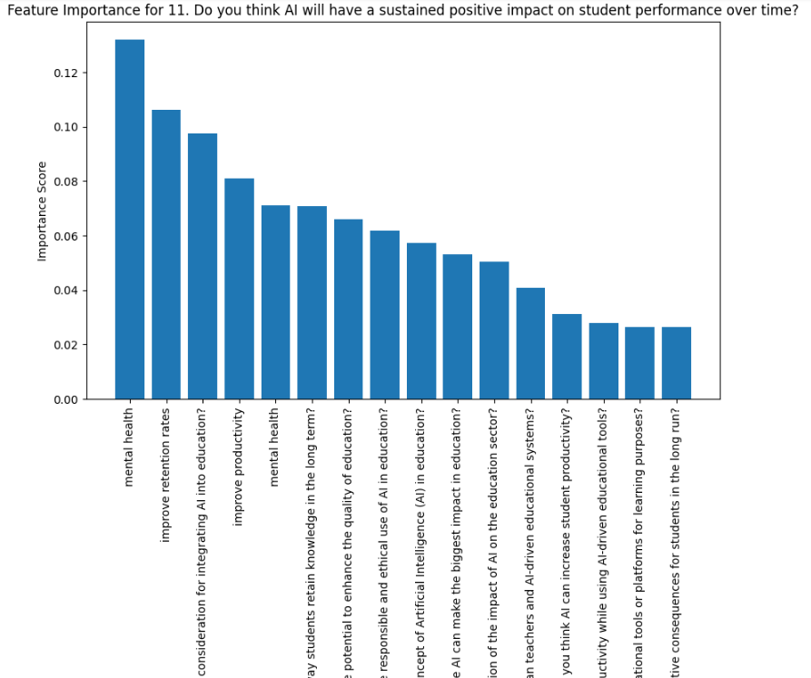
Result and Analysis
AI's Positive Impact on Student Performance:
Top features:
AI tools for mental health (0.1319)
AI's impact on retention (0.1063)
AI integration in education (0.0976)
Recommendation: Prioritize mental health tools, retention improvements, and addressing integration factors.

Slide 18
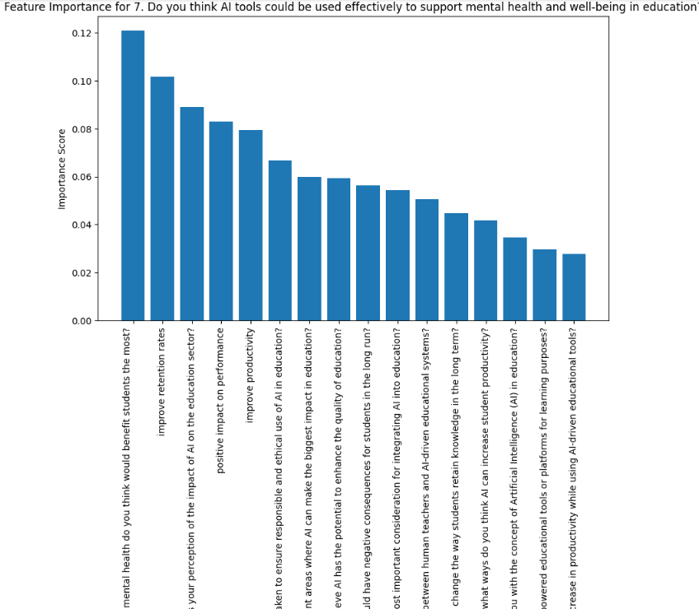
Result and Analysis
AI Tools for Mental Health and Well-Being:
Top features:
AI tools for mental health (0.1209)
AI's potential to improve retention (0.1015)
Recommendation: Enhance AI tools for mental health and focus on improving retention.

Slide 19
Conclusion
This study demonstrates the transformative potential of AI in education across four key areas: student retention, productivity, mental health support, and academic performance. The correlation matrix highlights strong relationships between AI-driven interventions and factors like knowledge retention, productivity, and performance, emphasizing AI's multifaceted impact. Random Forest analysis further validates AI's effectiveness, with high classification accuracy (82–88.5%) across all goals, underscoring its utility in enhancing educational outcomes. Feature importance analysis reveals mental health tools, retention strategies, and productivity enhancements as critical focus areas. These findings suggest prioritizing the development and integration of AI tools tailored to mental health, retention, and performance to maximize their educational benefits.

Slide 20
References
S. Z. Salas-Pilco and Y. Yang, "Artificial intelligence applications in Latin American higher education: A systematic review," International Journal of Educational Technology in Higher Education, 19(1): 20-21, 2022.
I. Khan, A. R. Ahmad, N. Jabeur, and M. N. Mahdi, "An artificial intelligence approach to monitor student performance and devise preventive measures," Smart Learning Environments, 8(1):15-16, 2021.
D. Bonilla-Jurado, R. Zambrano, and H. Moncayo, "Desarrollo profesional continuo de docentes para actividades en los Institutos Tecnológicos: Una revisión literaria," Revista Científica UISRAEL, 10: 21–34, 2023.
G. J. Hwang, H. Xie, B. W. Wah, and D. Gašević, "Vision, challenges, roles and research issues of Artificial Intelligence in Education," Computers, Education and Artificial Intelligence, 1: 100000-10001, 2020.
Z. Tauber et al., "Students’ preparedness, learning habits, and the greatest difficulties in studying Histology in the digital era: A comparison between students of general and dental schools," European Journal of Dental Education, 25(3):360–375, 2021.
T. Alqahtani et al., "The emergent role of artificial intelligence, natural learning processing, and large language models in higher education and research," Research in Social and Administrative Pharmacy, 19(9):1227–1243, 2023.
Hasas, A., M. S. Zarinkhail, M. Hakimi, and M. M. Quchi, "Strengthening Digital Security: Dynamic Attack Detection with LSTM, KNN, and Random Forest," Journal of Computer Science and Technology Studies, 6(1): 30–55, 2024.
E. Mora, D. Bonilla-Jurado, L. Núñez, and J. Sarmiento, "Inadaptabilidad de los Docentes al Manejo de Plataformas Virtuales: Caso EducarEcuador," Revista Conrado,14:80–91, 2018.
Y. Dai, A. Liu, and P. C. Lim, "Reconceptualizing ChatGPT and generative AI as a student-driven innovation in higher education," Procedia CIRP, 119: 80–89, 2023.
A. Al Ka’bi, "Proposed artificial intelligence algorithm and deep learning techniques for the development of higher education," International Journal of Intelligent Networks, 4(1): 65–71, 2023.

Slide 21
THANK YOU

